Slide 1

Project Kick-off Meeting
Reminder365 27-September-2017
Prepared by:
Aliabbas – Project Manager

Slide 2
Purpose
Ensure that all project participants begin the project with a clear and shared understanding of the project and project expectations.

Slide 3
Agenda
Goals
Scope
Approach
Deliverables
High Level Timeline
Team Roles and Responsibilities
Next Steps
Questions

Slide 4
Goals
Design and Develop Reminder 365 web application
Manage and monitor the expiry dates of equipment,
certificates and contracts.
Consolidate the expiring items of the same category and send an email

Slide 5
Scope
Login and Logout
Manage User Group and Role
Manage User within User Group
Equipment Reminder Module
Staff Reminder Module
Contracts Reminder Module
Notifications
Dashboard
Deployment of software to PSA servers

Slide 6
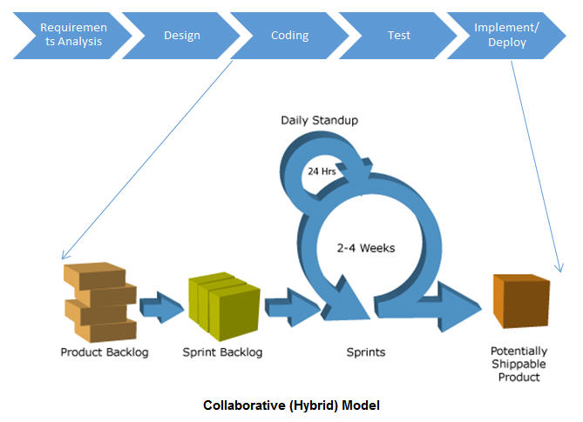
Approach
Recommend collaborative model

Slide 7
Approach
More emphasis on Initiation which comprises of
Goal or Outcome, Gathering Requirements, Design & Architecture, UI/UX Interfaces
Construction/Development
Multiple : Sprints, Releases, UAT etc.
Integration, Final UAT and Deployment
Quality Assurance
Risk And Change Management
Communication
Weekly Status Meeting/Report
Monthly Progress Meeting

Slide 8
Risk / Challenges & Mitigation
On-time Response
Effective communication through e-mails, calls and in-person meetings
Delays in decision making & sign-offs
Prior intimation & on-time delivery from Saksoft
Timely review and sign-offs from PSA
Communication between PSA and Offshore team
Setup a communication mode and single point of contacts
Delay in environment setups
Start planning environments early in the project
Integrations (Active Directory)
Test sample code before SIT starts

Slide 9
Deliverables
Project Management Plan
Requirement
Business Requirement Document
UI mockups
Design
High level & Low level Design Document
Source Code
Testing
Test Strategy & Test Plan
Integration, User Acceptance & Final Acceptance test cases
Manuals
User Manuals (For Admin & other users)

Slide 10
Timeline
 | 10/2 | 9/10 | 16/10 | 23/10 | 30/10 | 6/11 | 13/11 | 20/11 | 27/11 | 4/12 | 11/12 | 18/12 | 25/12 | 1/1 | 8/1 | 15/1
 | 1 | 2 | 3 | 4 | 5 | 6 | 7 | 8 | 9 | 10 | 11 | 12 | 13 | 14 | 15 | 16
Requirement Gathering
System and UI Design
Framework Setup
User Management
Equipment Reminders
Staff Reminders
Contract Reminders
Notifications
Dashboards
SIT/UAT
* Indicative Plan. Final plan will be submitted after Requirement gathering is completed * Testing including FAT will go in parallel with module development

Slide 11
Technology Stack
Java
Spring MVC
AngularJS
Javascript and Supporting Javascript Libraries
MySQL
Hibernate
Application Server - TBD

Slide 12
Team Structure
Executive Management
Abhishek Porwal
CTO
Bhaskar
Sales Head
PMO Management
Aditya Nalla
Delivery Manager
Aliabbas (Ali)
Project Manager
Krishna
Account Owner
Innovation Council Team
Delivery and Process Team
Innovation Council
App CoE
Abhishek
IM CoE
Jonathan Eeley
Technology Team
Architect
Sourabh
Product Managet
Abhishek S
QA Team
Roshan
Dev Team
Vijendra
Chandan
Testing CoE
Vivek
Engineering Process Team

Slide 13
Team Roles & Responsibility
Role | Person | Responsibility
Steering Committee Project Director | PSA – SakSoft - Bhaskar/Abhishek P / Krishna / Ali | Review overall engagement level performance Provide strategic directions for the engagement KPI Goals and Status n Project Sponsor with overall decision-making authority
Delivery Manager | PSA – Saksoft – Aditya Nalla | Account Owner Delivery Owner
Escalation Manager | 1st Level – Ali 2nd Level – Aditya Nalla 3rd Level – Abhishek | Point of contact for escalations Key stakeholder during project reviews
Project Manager | PSA – Saksoft – Ali Saksoft (Offshore) - Abhishek S | Customer issues (need of customer time, frequent changes in scope, providing information) Key stakeholder for project reviews Allocation of resources to the project Project Closure
Development Team | Vijendra (Team Lead) Abhishek S (Product Manager) | Requirement Gathering UI Design Coding Unit test
QA Team | Roshan | Creation of Test Plan, Test Scenarios, Test Cases Overall execution of project ensuring quality and schedule adherence

Slide 14
Team Roles & Responsibility
Name | Role | Contact Details | Escalation Level
Aliabbas Khambata | Project Manager | aliabbas.k@saksoft.com +65 96631335 | I
Aditya Nalla | Delivery Manager | nitin.mishra@dreamorbit.com +91 9741112541 | II
Abhishek Porwal | CTO | abhishek.porwal@dreamorbit.com +91 9620206031 | III

Slide 15
Monitoring & Tracking
# | Components to Track | Tracking Mechanism | Frequency | Stakeholders
1 | Milestones with respect to Activities | Project Plan | Once/When updated | Ali, Abhishek S
2 | Tasks done yesterday Planned tasks for today Any blocks | Daily Standup | Daily | Ali, Vijendra
3 | Risks/Issues | Risk / Issue Log | Continual | Ali, Abhishek S
4 | Metrics | Project Dashboard | Monthly and at End of Phase | Ali, Abhishek S
5 | Internal Meeting | Tasks Tracker | Daily, Weekly | Ali, Abhishek S & Team
6 | Client Meeting | Project Summary Report | Weekly | Ali, Abhishek S
7 | Steering Committee Review | Progress Report | Monthly | Aditya, Krishna, Ali

Slide 16
Dashboards & Reports
# | Review Meeting Type | Frequency | Participants | Associated Records
1 | Project Highlight Report | Weekly | PSA – SakSoft – Ali, Abhishek S | Weekly Activity report
2 | Project Summary – High Level Dashboard | Monthly | PSA – SakSoft – Ali, Abhishek S | Project Summary Report along with Metrics Report
3 | Change Track Sheet | As and when updated | PSA – SakSoft – Ali, Abhishek S | Change Tracker

Slide 17
Next Steps
Identify Business User Groups for Requirement Gathering
Schedule for Requirement Gathering
Prepare Project Management Plan
Elaborate the requirements to prepare Product Backlog and User Story Documents
Meetings
AS-IS and TO-BE modelling
Brainstorming
Prepare UI/UX mockups
System Design and Architecture
Establish process guidelines & overall project governance

Slide 18
Critical Success Factors
Following QMS and Project Management methodology
Tracking & Planning from phases to task level
Risk Analysis & Intimation throughout
Simple training material & plan
Strong Customer Involvement & Support
Proven Management Support
Strong Escalation Model
Full Commitment & Effective Communication

Slide 19
QUESTIONS?

Slide 20
Thank you. Let us get started!

